Slide 1

NeuroDOT
Tutorial:
Using the AlignMe App

Slide 2
What is AlignMe
AlignMe is NeuroDOT’s interactive array placement app, which allows for users to orient an optode array on a pre-existing head mesh
Key AlignMe functionality
Position array in relation to mesh
Relax array onto the surface of mesh
Scale mesh to participant specific values
Display participant photos to help with array placement optimization
AlignMe was designed and optimized in Matlab2020b, please ONLY use AlignMe in Matlab2020b

Slide 3
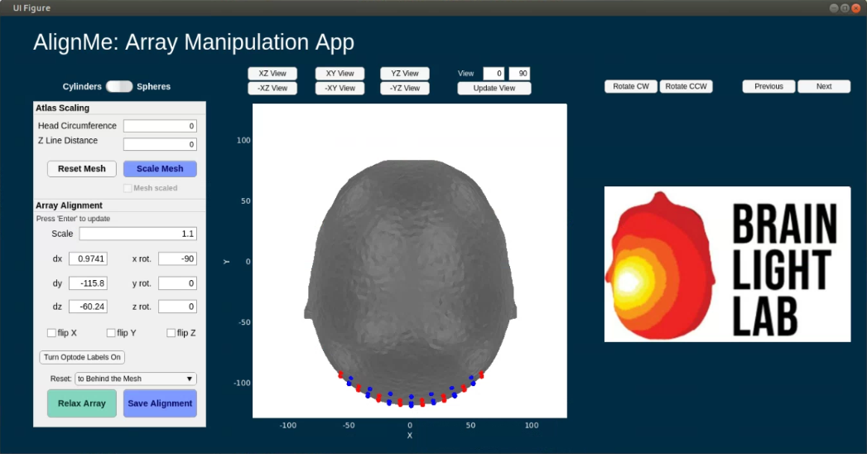
AlignMe Functionality
AlignMe allows for the user to scale the mesh to participant specific space by using
Participant Head Circumference
Participant Z line distance (nasion to inion)
These are contained within the Atlas Scaling box
Additionally, to facilitate easier alignment for participant specific situations, photos of the capfit can be utilized, and will show up where the Brain Light Lab logo is located on the GUI
Rotate CW, Rotate CCW: rotates photo
Previous, Next: scroll through available photos
Participant photos can be loaded in by setting the path to the directory containing photos. AlignMe will pull all files of the designated image type
Path to photos: ds.dI.photopath
Type of image: ds.dI.imageType
Note: This tutorial contains a “hands on” walkthrough section
The mesh will not be scaled in this tutorial
There will not be any participant photos in this tutorial
The tutorial script is titled AlignMe_Standalone_Tutorial.m
Tutorial script can be found in the Documentation/Scripts folder of the NeuroDOT toolbox

Slide 4
AlignMe Inputs
AlignMe uses a custom DataStorage class to load variables from the matlab workspace into the app
The DataStorage class functions similar to a structure in matlab and has two sub-structures
dI: input
User sets this before launching AlignMe
dO: output
Contains updated variables
User sets variables to these values after AlignMe has finished running
Sample Input structure
% Initialize DataStorage class
ds = DataStorage();
% Input structure
ds.dI.tpos = tpos;
ds.dI.mesh = mesh;
ds.dI.pad = info;
ds.dI.pM = pM;
ds.dI.paramsFoci = paramsFoci;
ds.dI.Ns = Ns;
ds.dI.photoPath = ‘’;
ds.dI.imageType = '.jpeg';
ds.dI.atlasFiducials = atlasFiducials;
Initial optode locations
Head mesh
Array information structure
General parameters
Array visualization parameters
Number of source optodes
Path to participant photos
File type for participant photos
Location of head landmarks
(in order)
nasion
Left pre-auricular point
Right pre-auricular point
Cz
Inion

Slide 5
AlignMe Walkthrough Tutorial 1
The next 22 slides are a hands-on tutorial for using AlignMe that follow the AlignMe_Standalone_Tutorial.m which can be found in the Documentation/Scripts folder of the NeuroDOT toolbox
We will use a head mesh created from the segmented volume: Segmented_MNI152nl_on_MNI111_nifti, found in Support_files/Atlases
We will use the visual pad, Pad_AdultV24x28.mat, found in Support_Files/Pad.
Lets start with loading in some variables you’ll need for this tutorial
These are the inputs detailed on the previous slide
%% Load inputs
load('AlignMe_Tutorial_Inputs.mat')

Slide 6
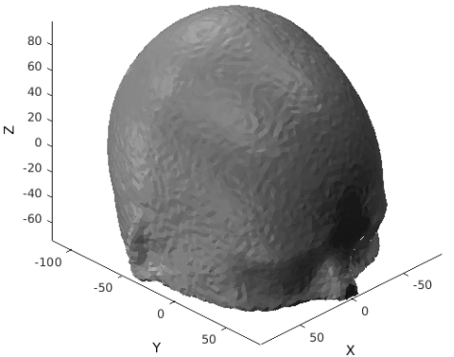
AlignMe Tutorial 2
Now, lets visualize the full head mesh
%% Visualize Mesh by itself
PlotMeshSurface(mesh,pM) %visualize in coordinate space
view([135,30]) %view the mesh where the nose of the head is pointing down and to the right
%this will give you a good view of where the center of the mesh is
Head Mesh

Slide 7
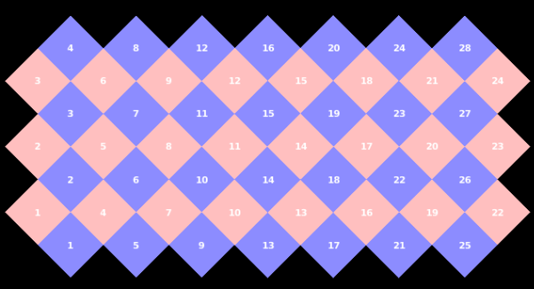
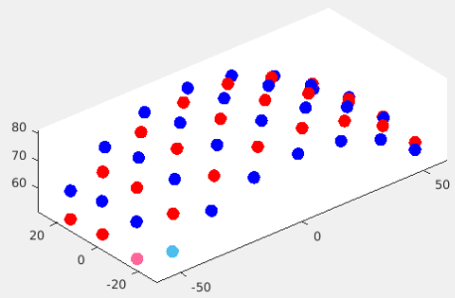
AlignMe Tutorial 3
Visualize the array in 2D and 3D
%% Visualize optode array (pad) by itself
figure
Draw_Foci_191203(tpos, paramsFoci);view([-40,30]) %3D plot of pad
PlotCap(info) %2D plot of pad
3D view of pad
2D layout of pad
Pink sphere = Source 1
Light blue sphere = Detector 1

Slide 8
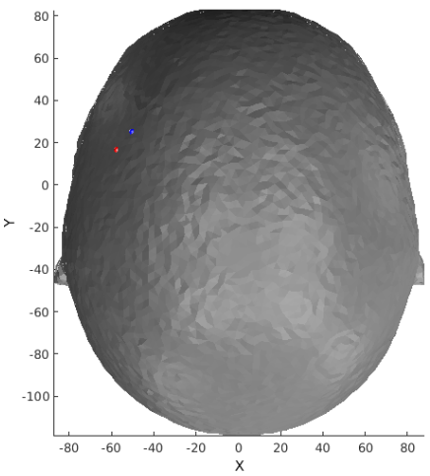
AlignMe Tutorial 4
Lets put it together and visualize the mesh and array in the same space
This will be where the array and mesh are positioned when AlignMe launches
Sometimes, the array’s starting position will be inside the mesh
Use AlignMe to re-position it to the correct location
Optodes, peeking out from mesh
%% Visualize mesh and array together
% Optodes have not been relaxed onto mesh yet
PlotMeshSurface(mesh,pM);Draw_Foci_191203(tpos, paramsFoci);
view([0,90])

Slide 9
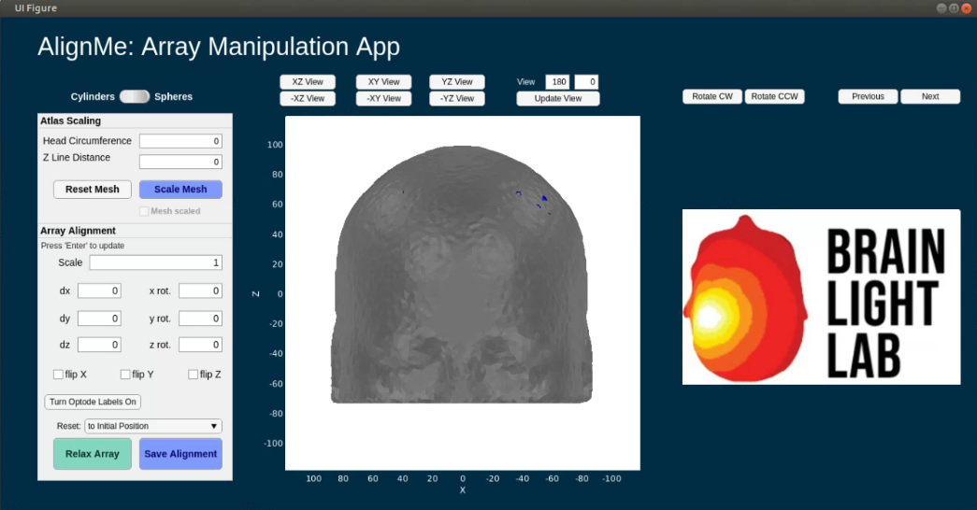
AlignMe Tutorial 5
There is a unique issue with running AlignMe on a LINUX device where you will be unable to change values in the edit fields on launch
This is due to a currently unresolved Matlab/Linux issue
To fix this, click on the “UI Figure” bar on the top of the app figure window
% Create an instance of our custom DataStorage HANDLE class
ds = DataStorage();
% Input structure
ds.dI.tpos = tpos;
ds.dI.mesh = mesh;
ds.dI.pad = info;
ds.dI.pM = pM;
ds.dI.paramsFoci = paramsFoci;
ds.dI.Ns = Ns;
ds.dI.photoPath = ‘’;
ds.dI.imageType = '.jpeg';
ds.dI.atlasFiducials = atlasFiducials;
% Run AlignMe
myapp=AlignMe_2020b(ds);
while isvalid(myapp); pause(0.1); end
Default view on AlignMe launch

Slide 10
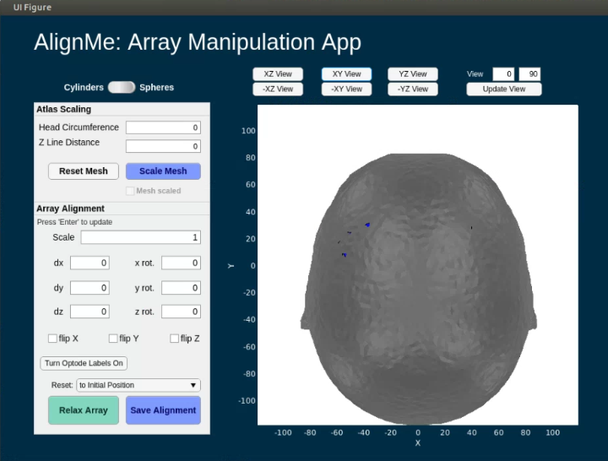
AlignMe Tutorial 6
Change the view to locate the pad
The pad is the grid comprised of red and blue spheres or cylinders
Sometimes the pad may be sitting inside of the mesh upon startup
Use XY view to start

Slide 11
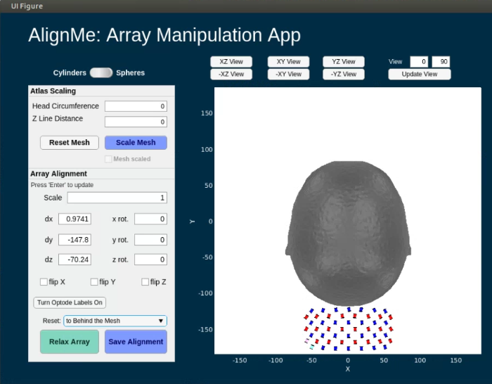
AlignMe Tutorial 7
Reset the pad to behind the mesh to visualize it
This is a visual pad which covers the occipital lobe and sits on the posterior surface of the mesh
Notice that the values changed for dx, dy, and dz
These are the changes in x, y, and z from the original position of the pad when AlignMe was initialized
Let’s reset the view and begin to line up the mesh

Slide 12
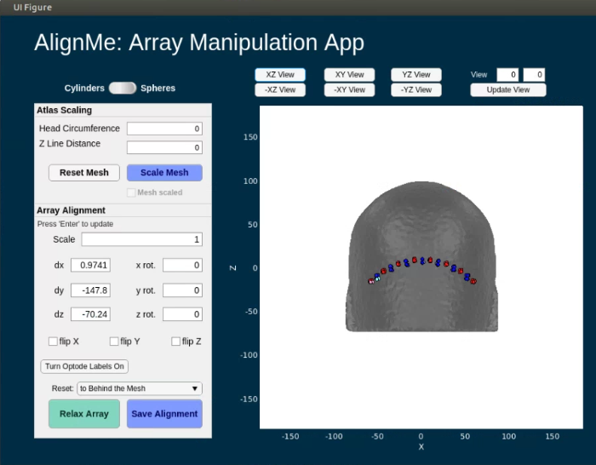
AlignMe Tutorial 8
Hit “XZ View” to navigate to a view which covers the back of the mesh
Now, lets rotate the pad so we can line it up

Slide 13
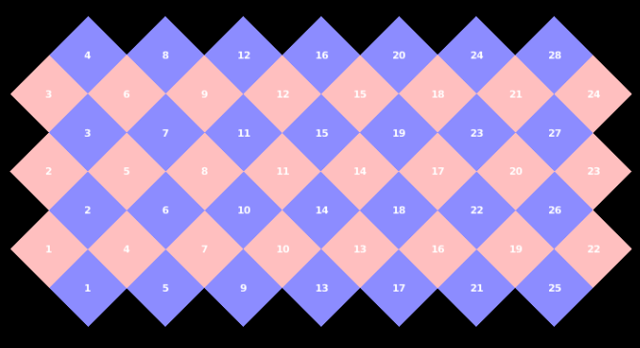
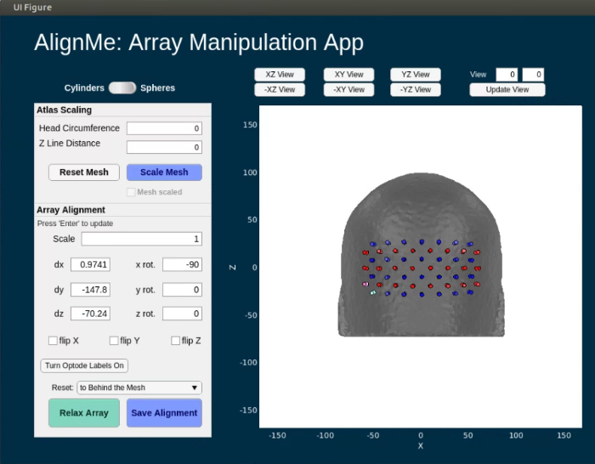
AlignMe Tutorial 9
Rotate the pad by modifying, x rot, y rot, or z rot, with the angle IN DEGREES that you want to rotate the pad by
Here we rotate the pad around the x axis by 90 degrees, x rot = -90
To update the array’s position after changing any value in the Array Alignment box, such as x rot: simply hit enter, tab, or click somewhere else on the app
The blue and pink sources and detectors (S/D) on the pad correspond to S/D 1, you can check this with the pad layout visualization generated earlier in the script
Line 89: PlotCap(info) %2D plot of pad

Slide 14
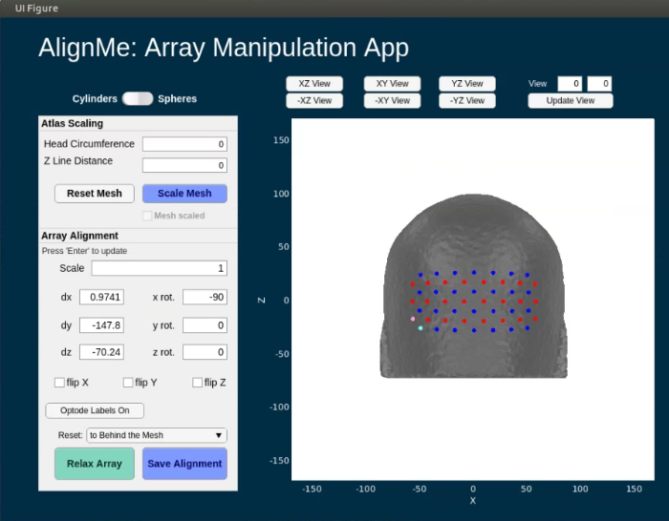
AlignMe Tutorial 10
Instead of using cylinders to denote the optodes, there’s an option for using spheres. Simply, flip the switch
Switch is located above the “Atlas Scaling” box
Future versions of AlignMe will allow for the user to specify spheres or cylinders as an input in the DataStorage handle class

Slide 15
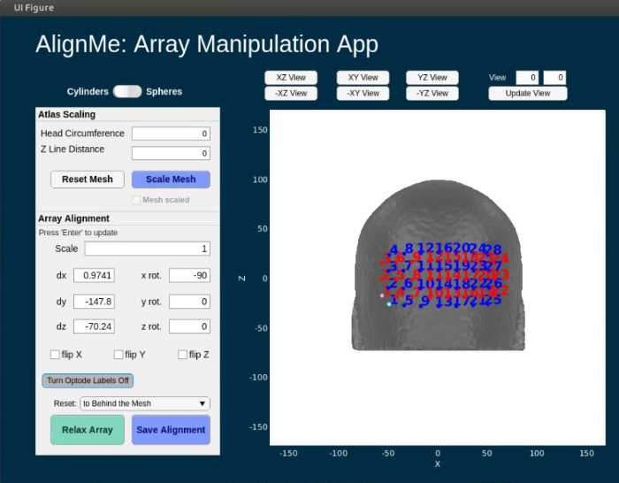
AlignMe Tutorial 11
Additionally, to better view the optode numbers, click the “Turn Optode Labels On/Off” button
If no numbers, button displays: Turn Optode Labels On
If numbers, button displays: Turn Optode Labels Off
We’ll turn the optode labels off for the rest of the tutorial

Slide 16

AlignMe Tutorial 12
Adjust the “Scale” to change the distance between optodes
Recommended Scale = 1.1
To update the array after changing any value in the Array Alignment box, such as Scale: simply hit enter, tab, or click somewhere else on the app

Slide 17

AlignMe Tutorial 13
The bottom row of optodes should line up with the very top of the ear.
Adjust “dz” to do this
Changed from -70.24 to -60.24
To update the array after changing any value in the Array Alignment box, such as dz: simply hit enter, tab, or click somewhere else on the app

Slide 18
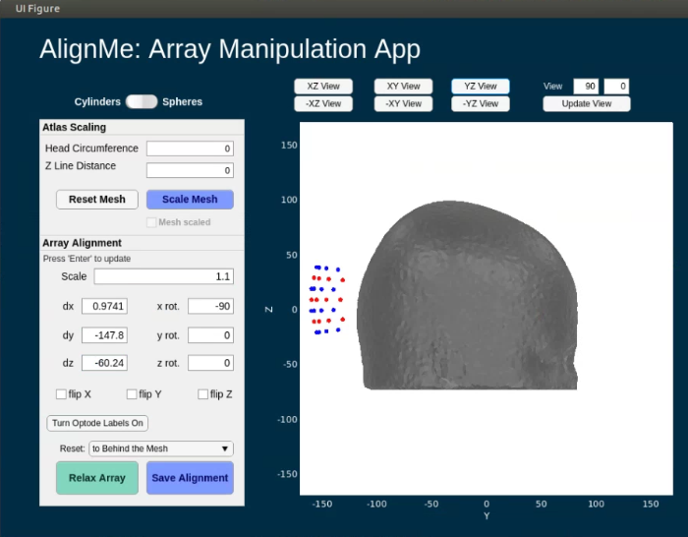
AlignMe Tutorial 14
Change to “YZ view”
Visualization check
The pad should be no more than 10mm away from the mesh
Let’s move it closer

Slide 19
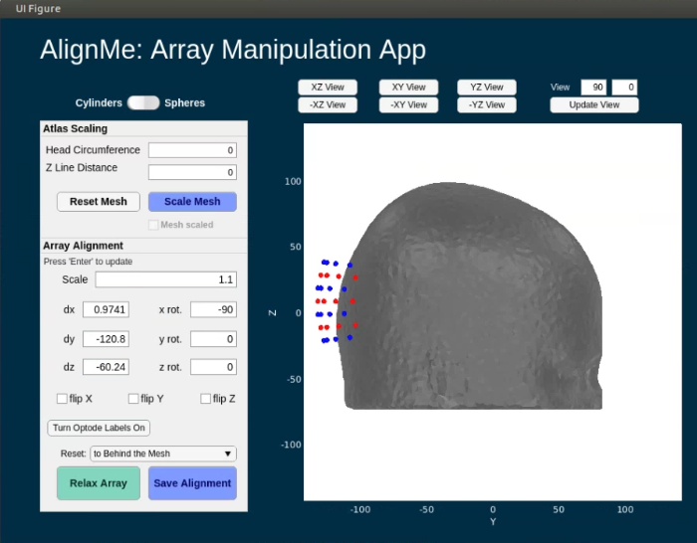
AlignMe Tutorial 15
Visualization check
The pad should be no more than 10mm away from the mesh
Let’s move it closer
dy changed from -147.8 to -120.8
To update the array after changing any value in the Array Alignment box, such as dy: simply hit enter, tab, or click somewhere else on the app
Let’s visualize in XY view one more time to check the distance

Slide 20
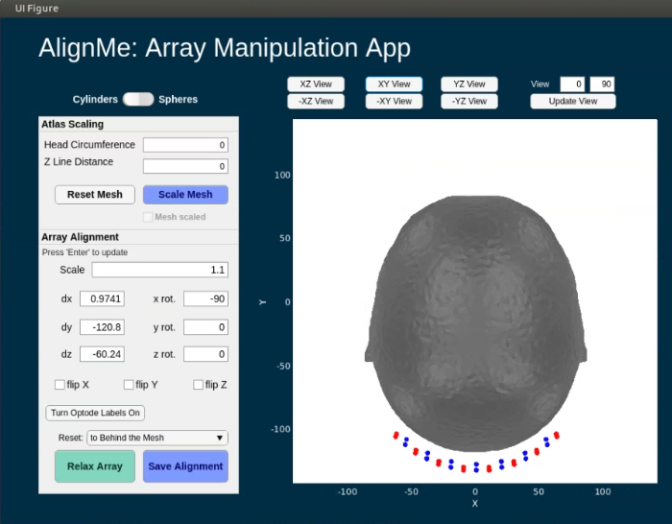
AlignMe Tutorial 16
One last visualization check
Hit “XY View”
We can move the pad slightly closer. Let’s adjust “dy” one last time

Slide 21

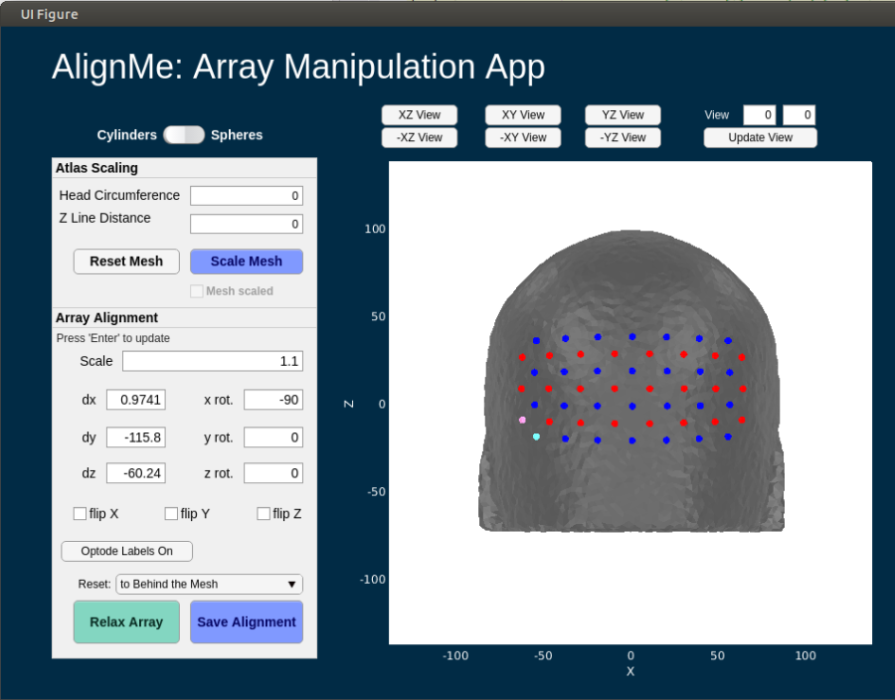
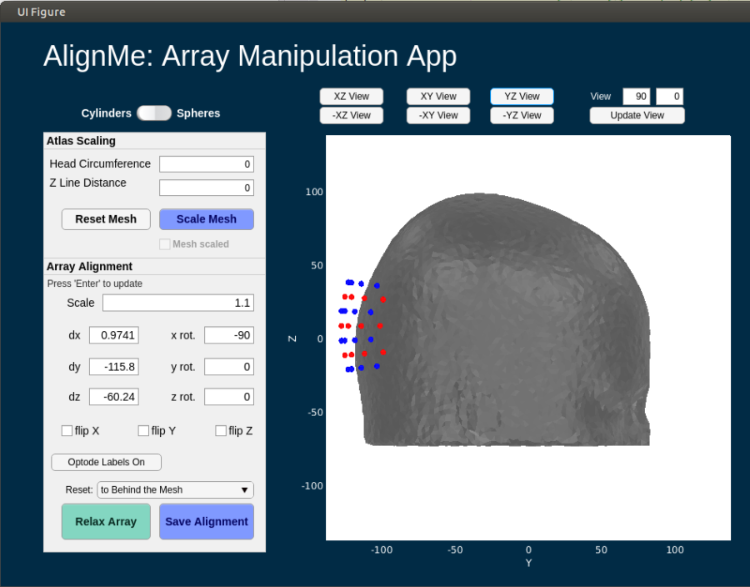
AlignMe Tutorial 17
XY view
Dy changed from -120.8 to -115.8
Looks good! Lets do one final sanity check of all 3 views
XZ view
YZ view

Slide 22
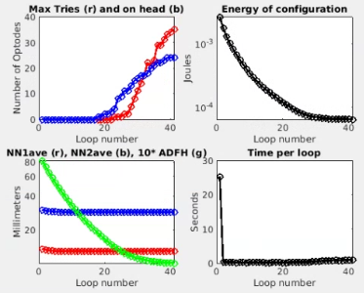
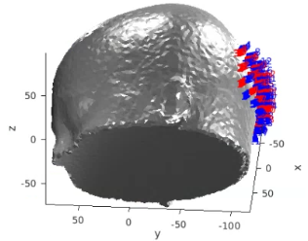
AlignMe Tutorial 18
Looks good! Now time to relax the grid onto the mesh
Hit the “Relax Array” button
Then, the below two figures will pop up and start to update as the array is relaxed onto the surface of the mesh

Slide 23
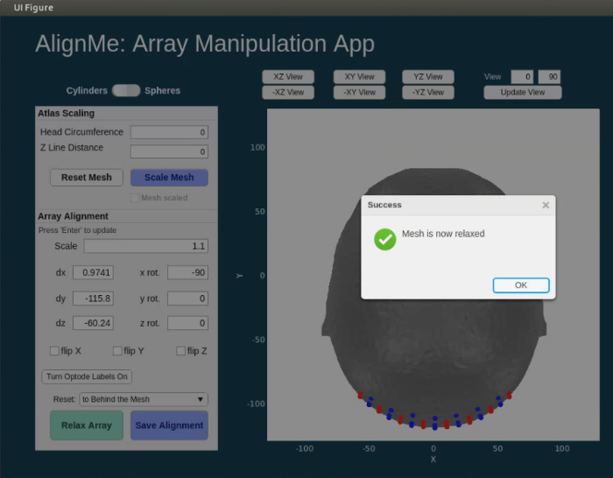
AlignMe Tutorial 19
Once optodes are relaxed onto the mesh, a dialogue box will show up on the AlignMe app
Hit “OK” to close the dialogue box

Slide 24
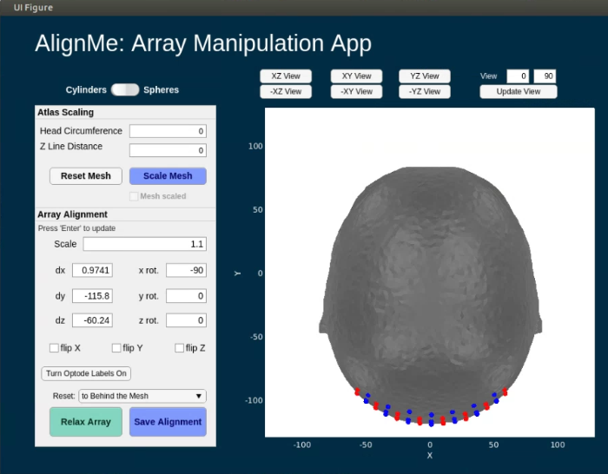
AlignMe Tutorial 20
To save the new optode locations to your MALTAB workspace, hit the “Save Alignment” button

Slide 25
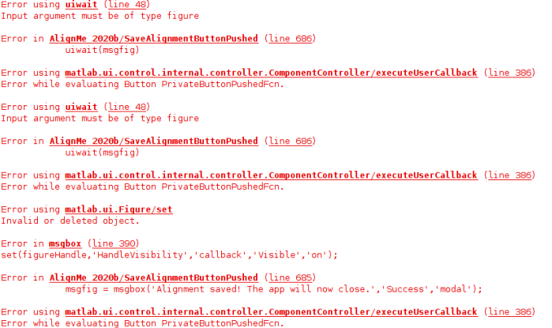
AlignMe Tutorial Potential Errors
Sometimes, when clicking the “Save Alignment” button, the error shown on the right occurs
Usually this is due to clicking the button multiple times before the app has finished running
To fix, just select 'Save Alignment' again
Make sure you only click once
Please be patient

Slide 26
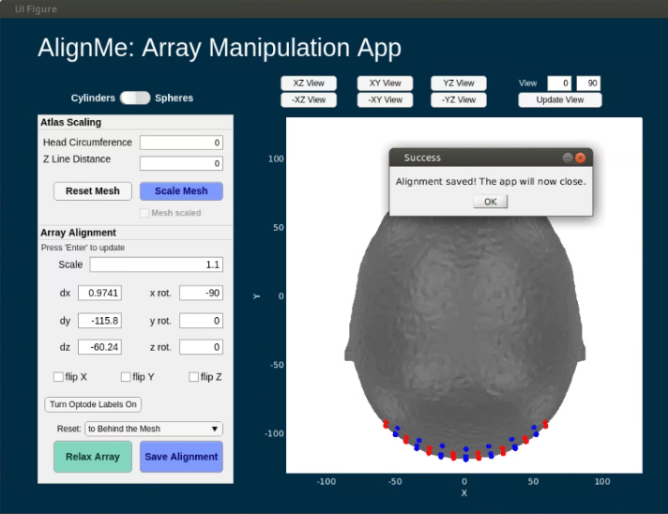
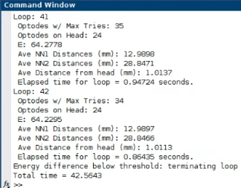
AlignMe Tutorial 21
A final dialogue box will open. Click OK to close AlignMe
You’ve finished the AlignMe tutorial!

Slide 27
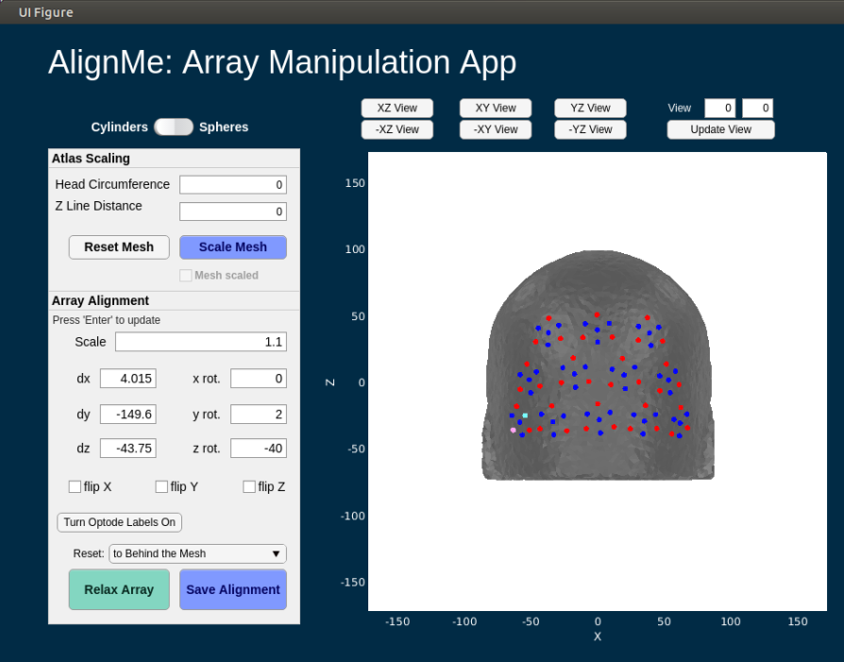
What Type of Arrays can You Use with AlignMe?
AlignMe is array-agnostic, meaning it can be used with any commercial array in addition to in-house arrays that your lab may have
Note: arrays must be converted to NeuroDOT format before use with AlignMe
See the appendix for information on converting your array to a NeuroDOT compatible pad file
NeuroDOT sample Visual Pad
Gowerlabs LUMO Visual Pad

Slide 28
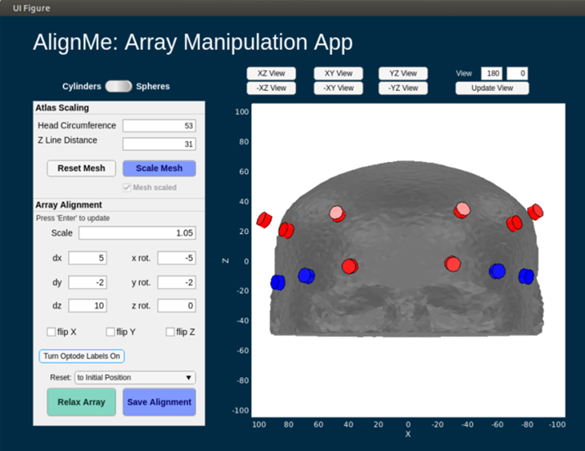
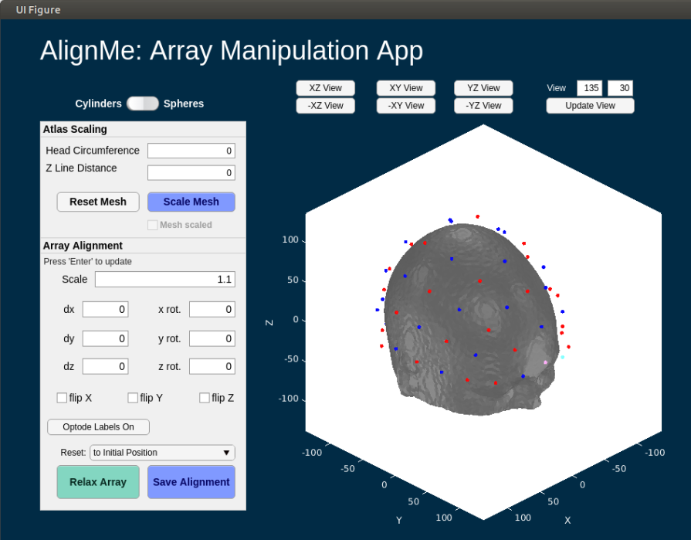
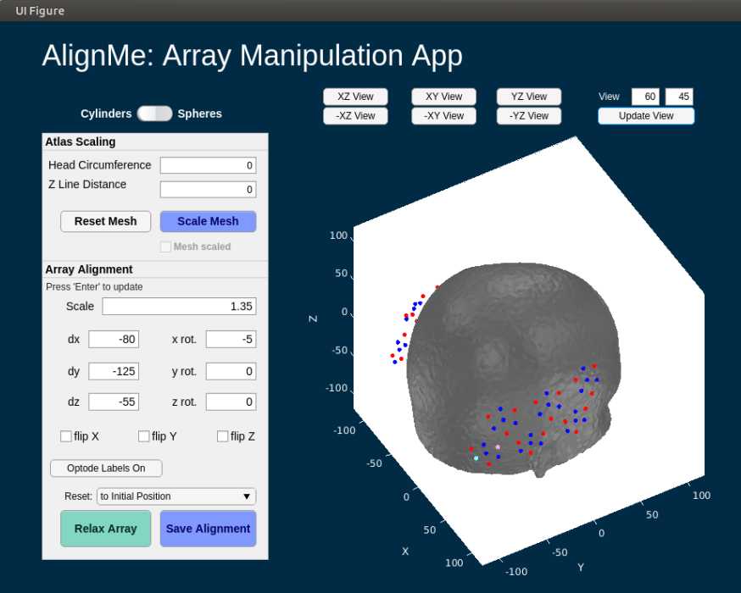
Examples with Common Commercial Array Designs
NIRX
Forehead pad
NIRX
Full head pad
Gowerlabs
LUMO
Visual pad
Gowerlabs
LUMO
Temporal pad

Slide 29
Appendix: Generating info for Pad file (1 of 3)
The Pad file for a given grid design contains a structure variable info that contains the spatial and topological information for the array as follows:
info.optodes
Structure containing spatial coordinates for sources and detectors in array
info.optodes.spos2 – 2D coordinates of each sources
info.optodes.spos3 – 3D coordinates of each source
info.optodes.dpos2 – 2D coordinates of each detector
info.optodes.dpos3 – 3D coordinates of each detector
info.pairs
Table containing topological information for each source-detector measurement pair
Each row of this table corresponds to a measurement and must be in the same order as the optical data for valid processing
Generally, full list of sources and detectors is repeated for each wavelength/lambda.
info.pairs.Src – source in measurement
info.pairs.Det – detector in measurement
info.pairs.NN – Nearest Neighbor class in array (e.g., info.pairs.NN=1 means this measurement is one of the closest in the grid design)
info.pairs.WL – wavelength index of measurement
info.pairs.lambda – actual wavelength of measurement (e.g., info.pairs.lambda-=750 is a 750 nm measurement)
info.pairs.Mod – Modulation type of measurement (e.g., ‘CW’, or, ‘FD’)
info.pairs.r2d – 2D source-detector distances
info.pairs.r3d – 3D source-detector distances

Slide 30
Appendix: Generating info for Pad file (2 of 3)
If you already have a grid design with 2D and 3D source and detector locations, saved as the following:
grid.spos2
grid.spos3
grid.dpos2
grid.dpos3
To generate the topology structure for your grid:
dr=5; % Distance separating 'nearest neighbor' groups
Rad=Grid2Radius_180824(grid,dr);
Once you have the grid and radius set up (as above), the info structure can be generated with the following:
grid.name='Your_Grid_Name';
params.lambda=[750,850]; % Wavelengths for your system
params.Mod='CW'; % Modulation strategy
[info]=Generate_Info_from_Grid_Rad(grid,Rad,params);
Then just save the Pad file for future use:
save(['Pad_',info.optodes.CapName],'info')

Slide 31
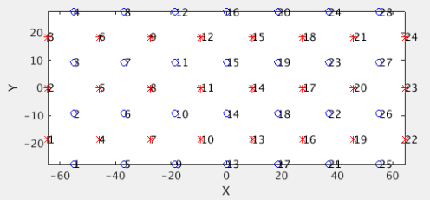
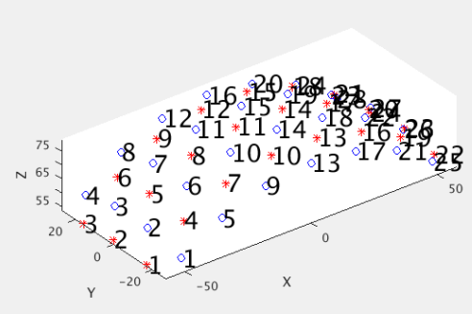
Appendix: Generating info for Pad file (3 of 3)
If instead you are designing a grid from scratch in style of our visual cap:
Ndy=4; % Num detectors in y-direction
Ndx=7; % Num detectors in x-direction
NN1sep=13; % Closest source-detector Separation
Srad=80; % Radius of spherical head model
[grid,Rad]=Make_Sphere_Cap(Ndy,Ndx,NN1sep,Srad);
As described above,
grid contains information on the positions of the sources and detectors.
Rad contains information on the topology of the array.
Visualize the grid in 2D and 3D
PlotSD(grid.spos2,grid.dpos2,'norm'); % Visualize 2D positions
PlotSD(grid.spos3,grid.dpos3,'norm'); % Visualize 3D positions
Then set parameters, generate info file as on previous slide, and save Pad file for future use.

Slide 32
That’s It (For Now)
Congratulations! You have finished the NeuroDOT Light Modeling Pipeline Tutorial for the basic 24x28 visual pad using AlignMe.
See other Sample Results Appendices for example visualizations of these same processing steps on the other Sample Data included in the toolbox.
Also, see the PreProcessing and Reconstruction tutorials to gain a deeper understanding of the effects of altering the processing parameters.
NeuroDOT-AlignMe Team:
Adam Eggebrecht (aeggebre@wustl.edu)
Emma Speh (espeh@wustl.edu)
Abby Magee (abigail.magee@wustl.edu)
Ari Segel (ari@wustl.edu)

